Slide 1






GROUP
PROJECT
Presented by G04

Slide 2

OUR TEAM
Cheng Leong Chan
Gea Linggar Galih
Zechuan Liu
Hexuan Wang
Ryan Foote

Slide 3

Motivation
The world is changing, and with it, the air we all share. Irregardless of our smart-city citizens' wealth, status, or power, their human body requires air without pollutants. This causes a great deal of anxiety for our citizens. Whilst our smart-city teams are working to eradicate damage caused by those that came before us, we need to find a way to minimize impact to our citizens in our city.

Slide 4
So what's the solution?

Slide 5
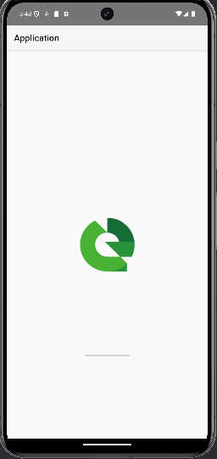



Slide 6
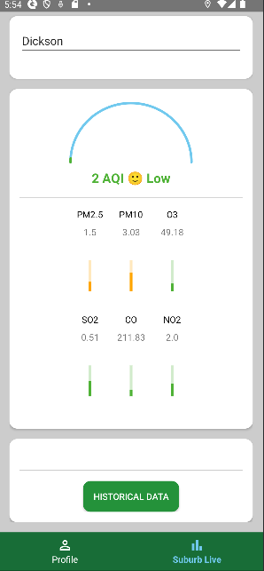
Goals
By providing a user-friendly application that tracks live and historical air-quality data indexed via suburb, our citizens move forth with the knowledge to make impactful and informed decisions for their safety in regards to the air they breathe.

Slide 7
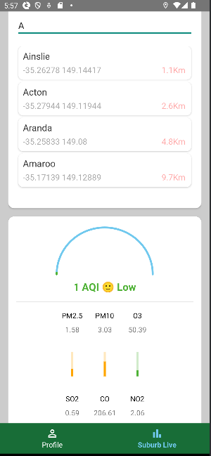
Also
By looking up a suburb they are thinking of visiting before making the journey, they can see trends in the levels of different molecules that make up our air as well as a general "Good or Bad" indicator.

Slide 8
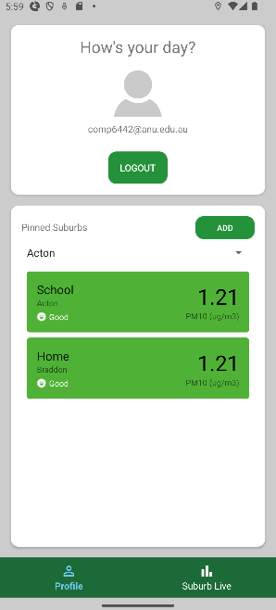
You can
To further aid the user, we individualized it to each citizen remember the suburbs they frequent so that they can access the most relevant information to them the quickest.

Slide 9
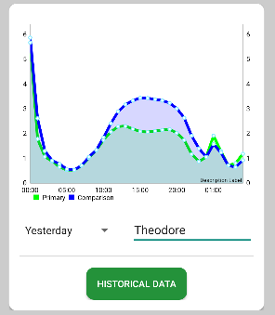
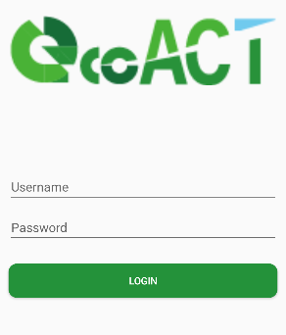
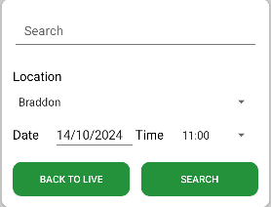
Explore Our app

Slide 10

Back-end
GPS Service-Layer
Execution Singleton
CSVParser DAO
To engage with Location services, we separated the logic into a separate service for the application. This abstraction enforced a consistent interface through a service.getRecentLocation() function. Using a service pattern also allowed swift change from being a standalone background service to a bound service.
To ensure safety when multi-threading, we implemented a singleton instance of the Executor class. .
It separates data access logic from the core business logic, improving maintainability and scalability.
And It makes it easier to switch between data sources without affecting the rest of the application. It Improves testability by allowing mock data sources during testing, making it easier to isolate and test individual components.

Slide 11
Data Structure
ArrayList
HashSet
Used to store unique combinations of suburb names and timestamps to prevent duplicate air quality records from being written to the CSV file.
Used for storing and managing a list of suburb details and historical air quality records dynamically as new data is fetched and displayed in the UI.
HashMap
AVL Tree
Used for storing suburb names as keys and their geographical coordinates as values to determine proximity in nearest suburb calculations.
Used for storing suburb data in a balanced manner to ensure efficient lookups, insertions, and deletions.

Slide 12
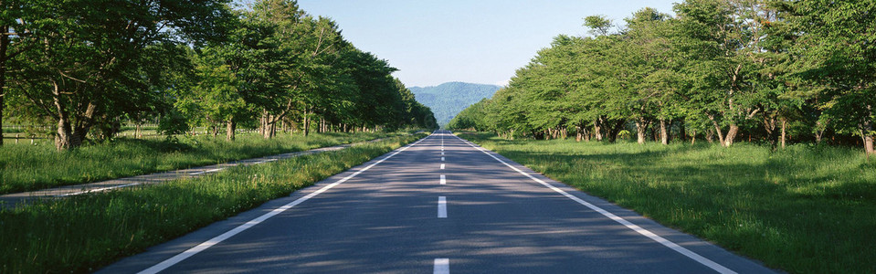


A healthier Life with ecoACT

Slide 13
THANK
YOU

